Slide 1

Joins and Subqueries

Slide 2
SQL JOIN
As the name shows, JOIN means to combine something.
In case of SQL, JOIN means "to combine two or more tables".
The SQL JOIN clause takes records from two or more tables in a database and combines it together.

Slide 3
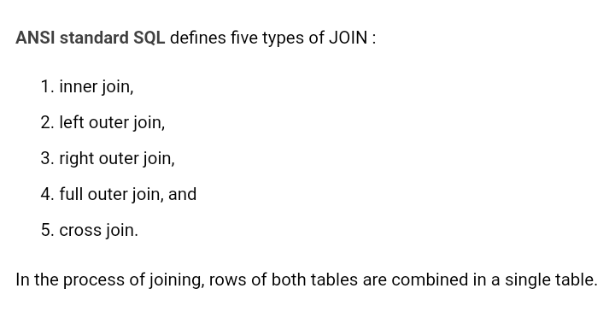

Slide 4
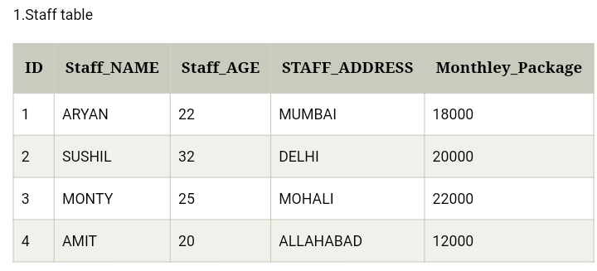
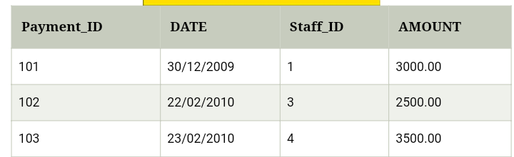
Inner Join
2.Payment table

Slide 5
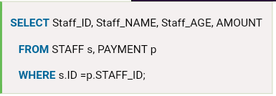
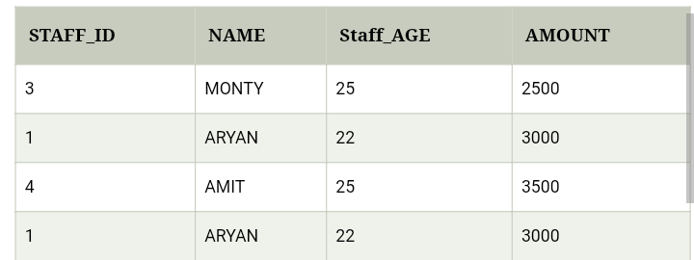

Slide 6
OUTER JOIN
Outer join of two types:
1.Left outer join (also known as left join): this join returns all the rows from left table combine with the matching rows of the right table. If you get no matching in the right table it returns NULL values.
2.Right outer join (also known as right join): this join returns all the rows from right table are combined with the matching rows of left table .If you get no column matching in the left table .it returns null value.

Slide 7
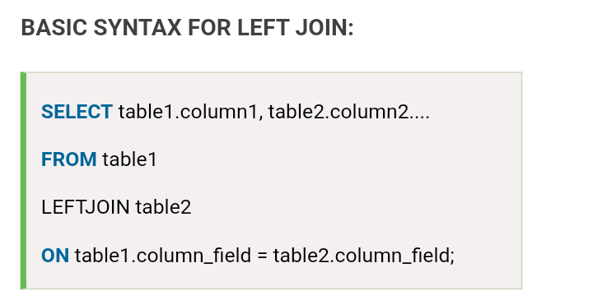
SQL LEFT JOIN
The SQL left join returns all the values from the left table and it also includes matching values from right table, if there are no matching join value it returns NULL.

Slide 8
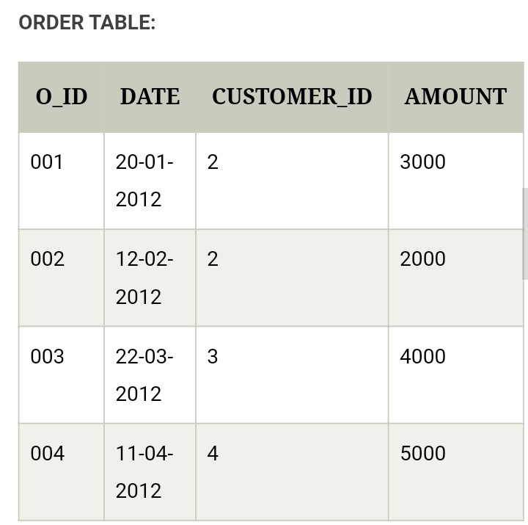
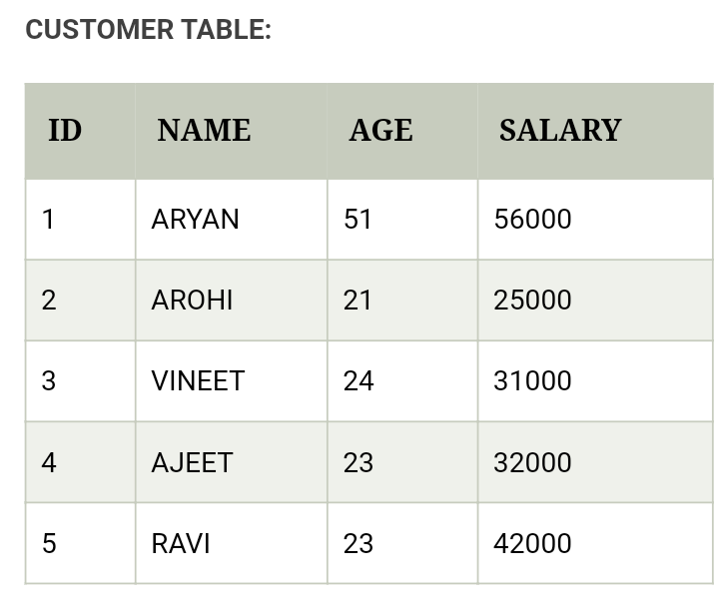

Slide 9
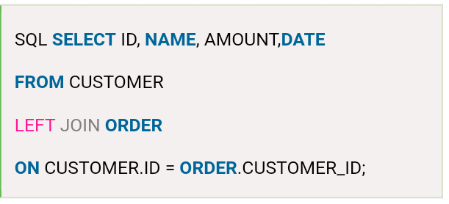
Join these two tables with LEFT JOIN:

Slide 10
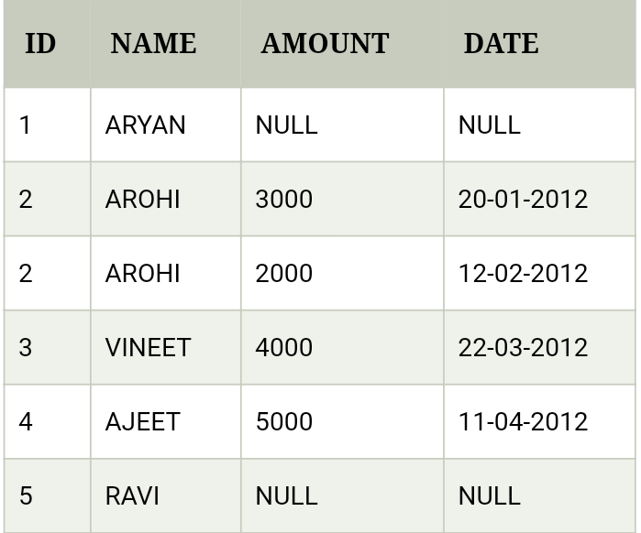

Slide 11
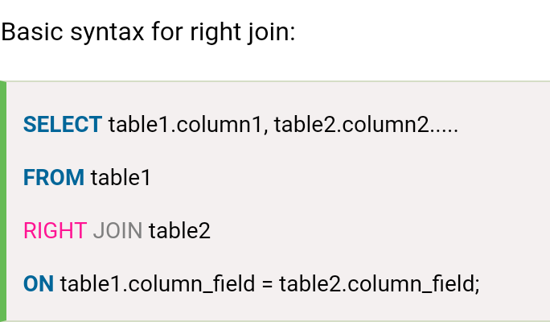
SQL RIGHT JOIN
The SQL right join returns all the values from the rows of right table.
It also includes the matched values from left table but if there is no matching in both tables, it returns NULL.

Slide 12
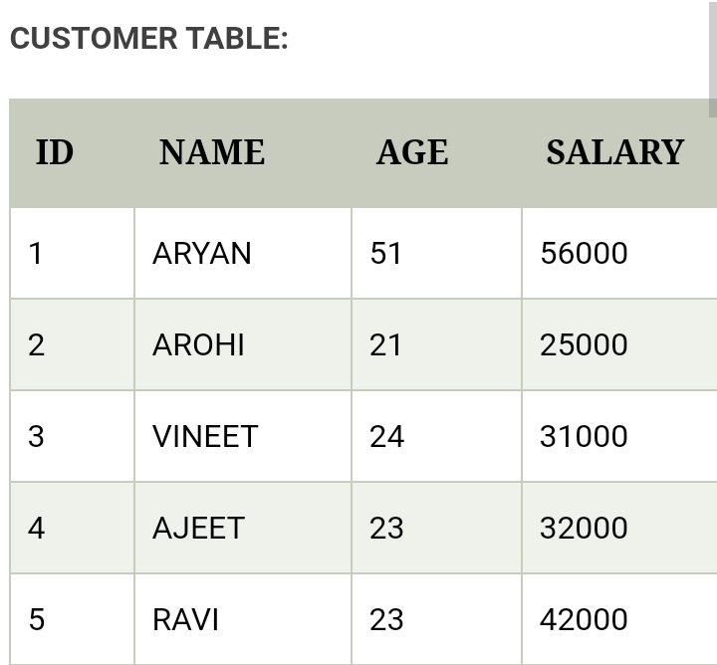
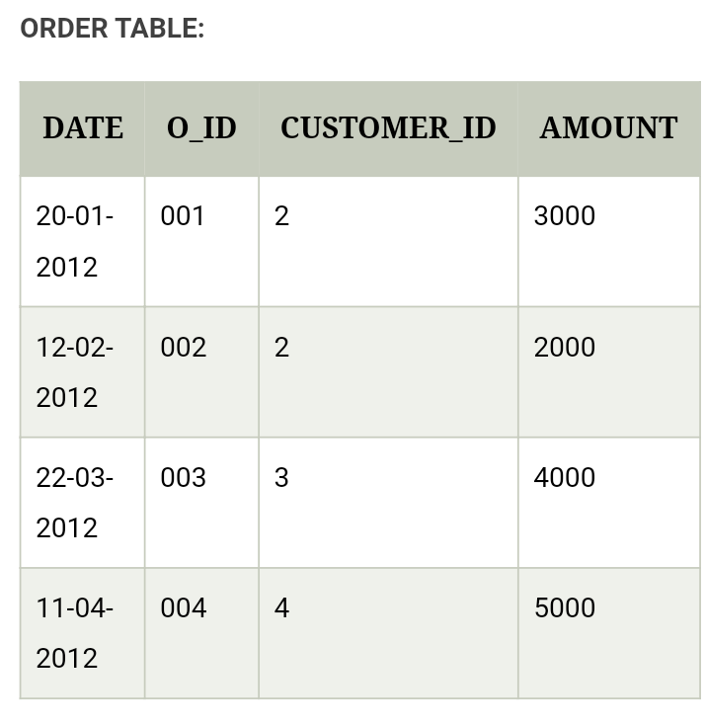

Slide 13
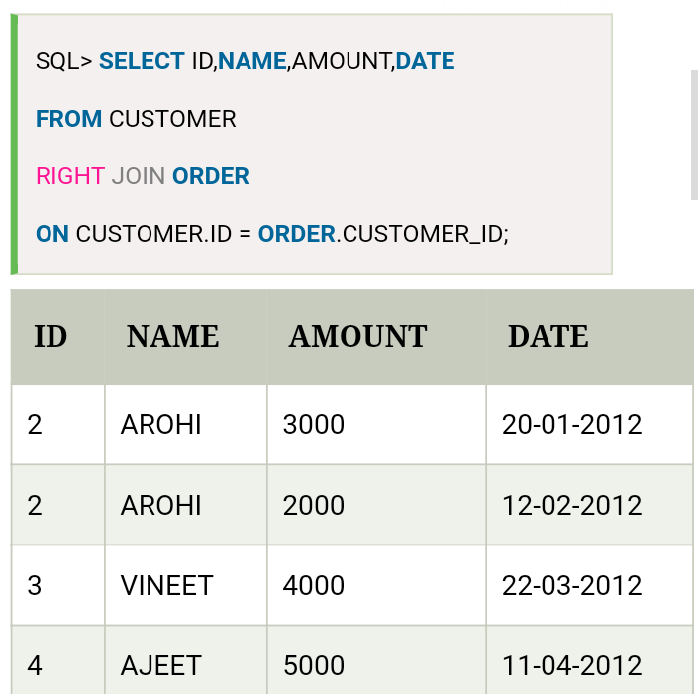

Slide 14
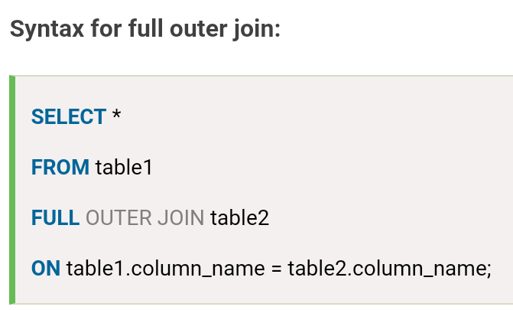
SQL FULL JOIN
The SQL full join is the result of combination of both left and right outer join and the join tables have all the records from both tables. It puts NULL on the place of matches not found.

Slide 15
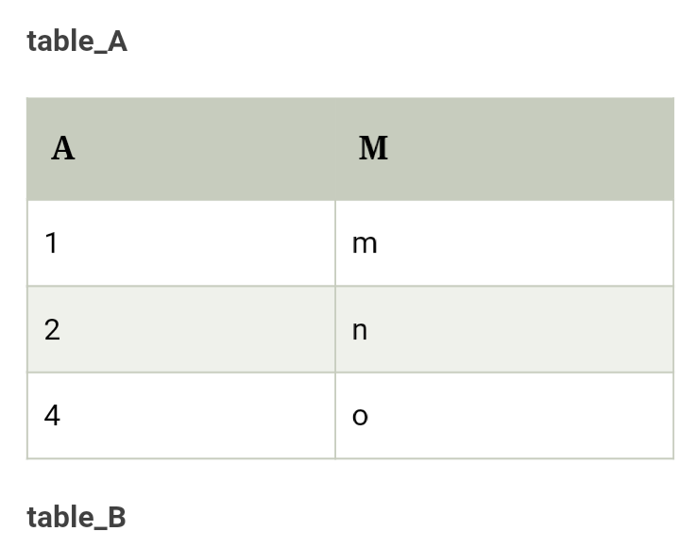
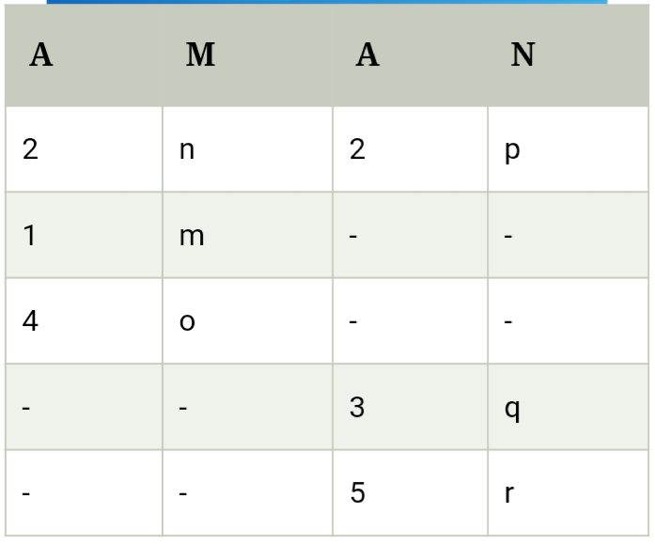
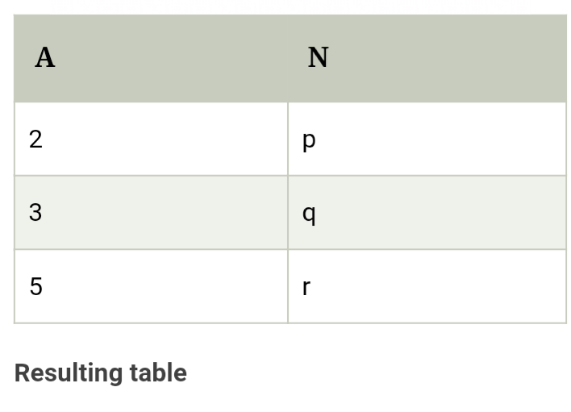

Slide 16
SQL Cross Join
When each row of first table is combined with each row from the second table, known as Cartesian join or cross join. In general words we can say that SQL CROSS JOIN returns the Cartesian product of the sets of rows from the joined table.
We can specify a CROSS JOIN in two ways:
Using the JOIN syntax.
the table in the FROM clause without using a WHERE clause.

Slide 17
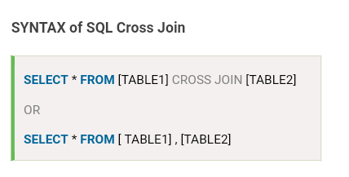

Slide 18
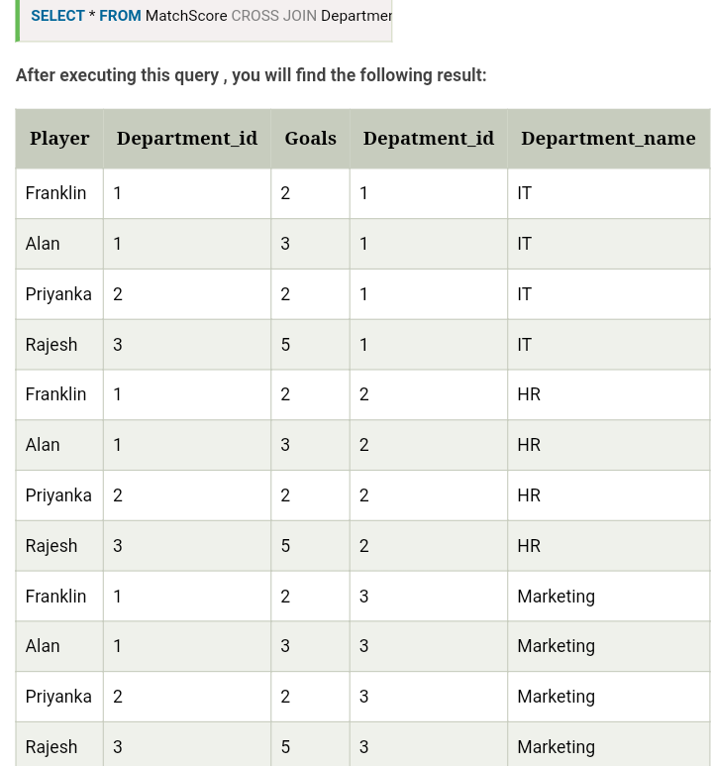

Slide 19
SQL Sub Query
A Subquery is a query within another SQL query and embedded within the WHERE clause.
Important Rule:
A subquery can be placed in a number of SQL clauses like WHERE clause, FROM clause, HAVING clause.
You can use Subquery with SELECT, UPDATE, INSERT, DELETE statements along with the operators like =, <, >, >=, <=, IN, BETWEEN, etc.
A subquery is a query within another query. The outer query is known as the main query, and the inner query is known as a subquery.
Subqueries are on the right side of the comparison operator.
A subquery is enclosed in parentheses.
In the Subquery, ORDER BY command cannot be used. But GROUP BY command can be used to perform the same function as ORDER BY command.

Slide 20
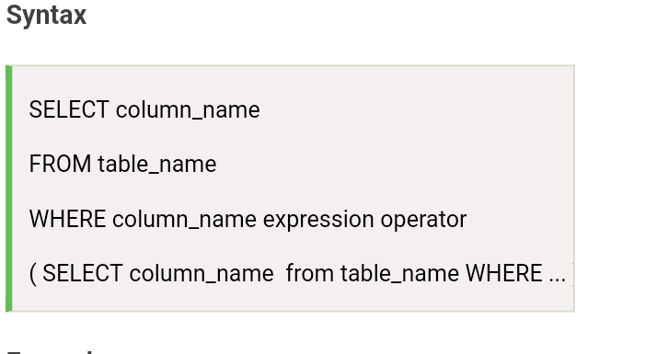
Subqueries with the Select Statement

Slide 21
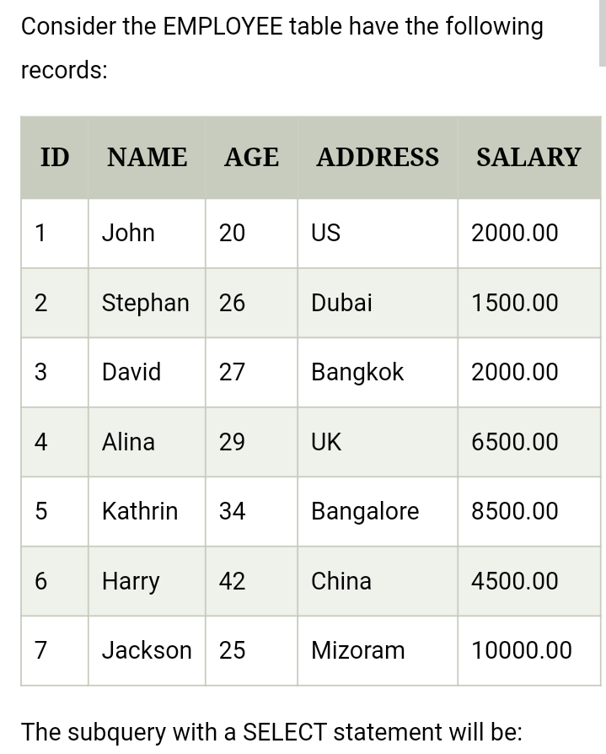

Slide 22
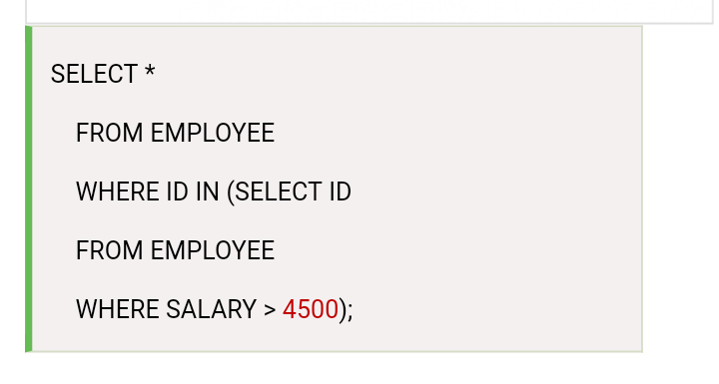

Slide 23
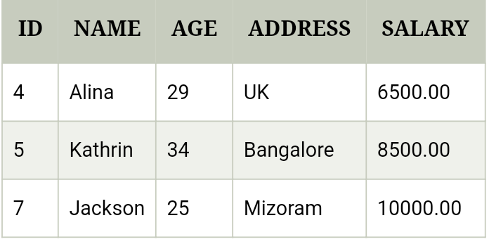

Slide 24
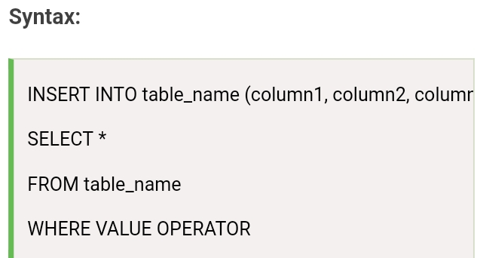
Subqueries with the INSERT Statement

Slide 25
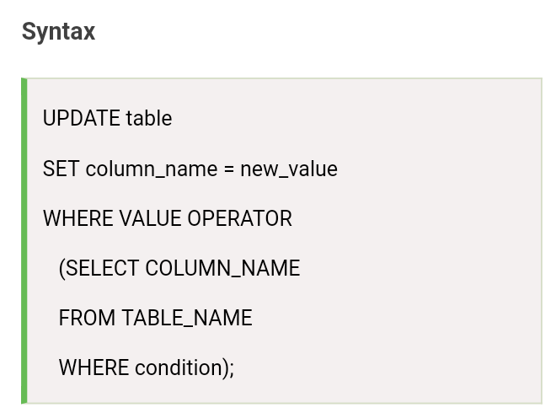
Subqueries with the UPDATE Statement

Slide 26
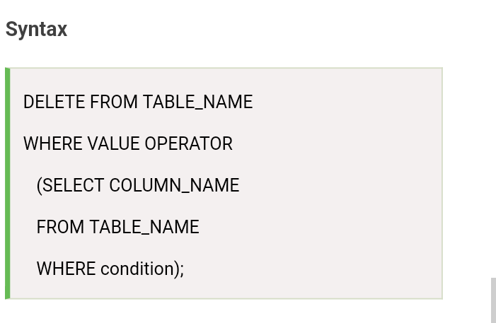
Subqueries with the DELETE Statement

Slide 27


